Slide 1


Presentation Part 2
CreatiForce

Slide 2


TABLE OF CONTENT
Introduction
Market research
Challenge statement
Business idea
Prototype iterations
Evaluation
Explanation gathered feedback
Explanation of the prototype

Slide 3


⁠44% of gym users in Amman, Jordan, consume dietary supplements
Secondary data
Market research
⁠The market size for protein supplements is on the rise as people become more aware of the importance of nutrition and exercise.
⁠Release of toxic chemicals that causes health diseases and air pollution

Slide 4
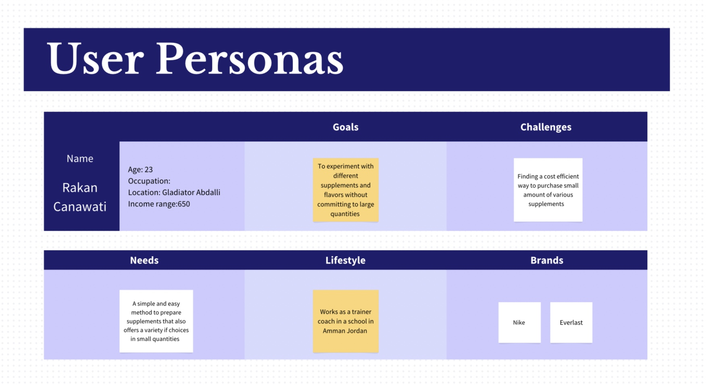
Targeted Persona’s

Slide 5
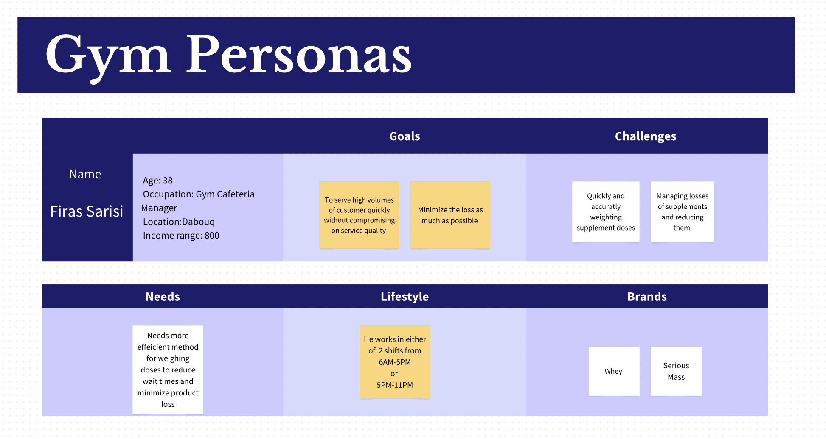
Targeted Persona’s

Slide 6


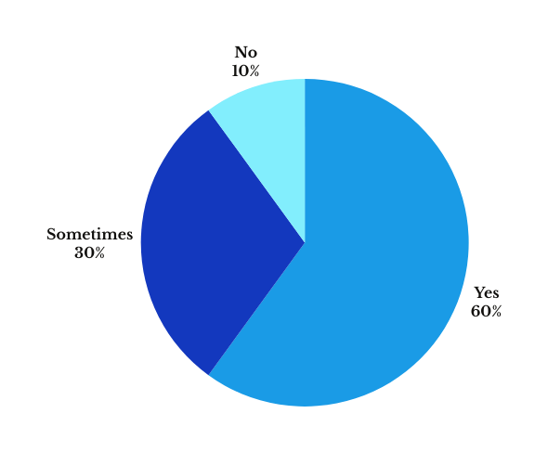
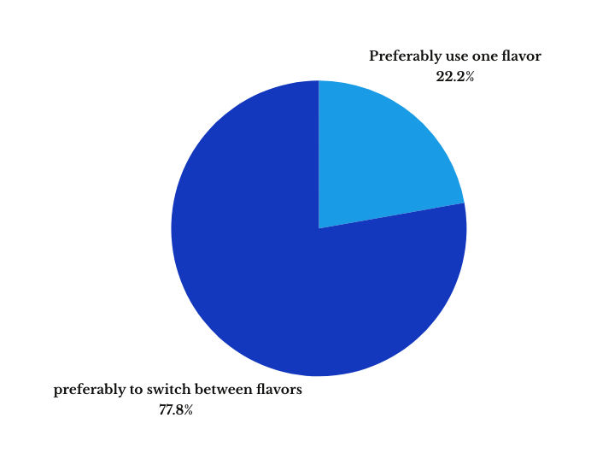

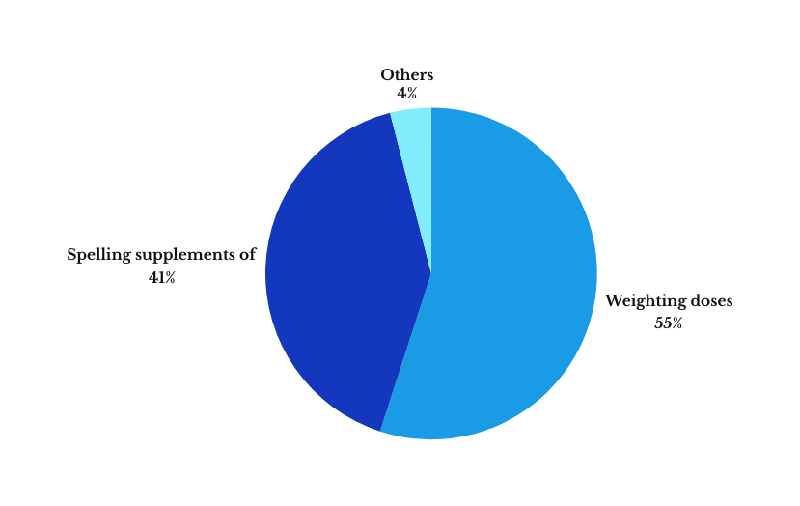
Primary data
Supplement preparation difficulty
Difficulties that are faced
Flavor

Slide 7
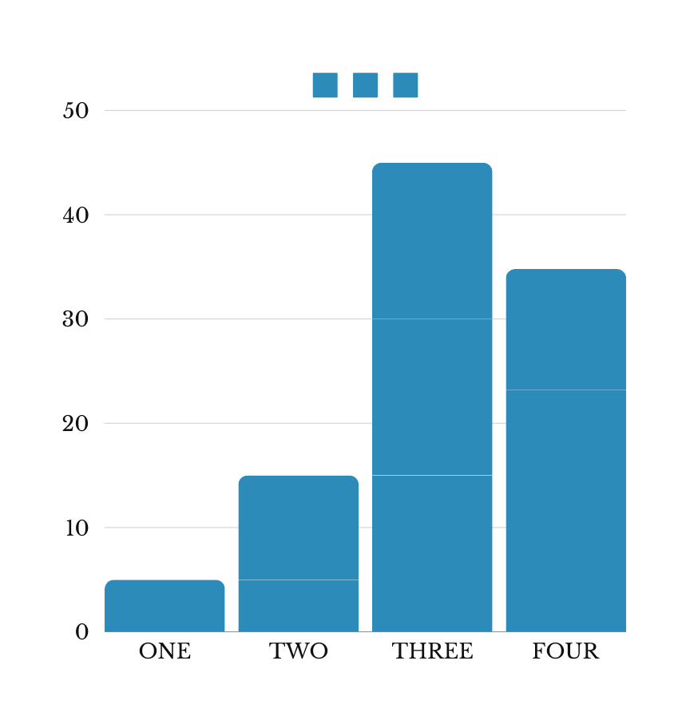
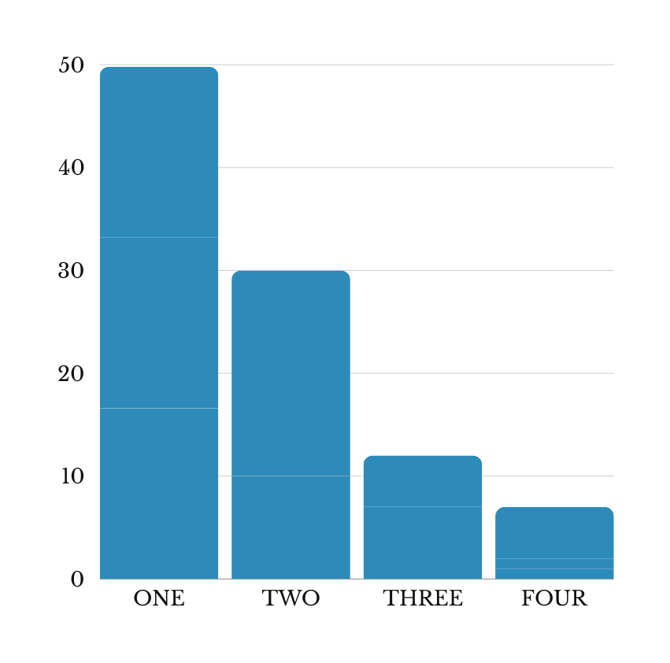
Number of supplements do you need each month
Number of supplements are taken each month

Slide 8
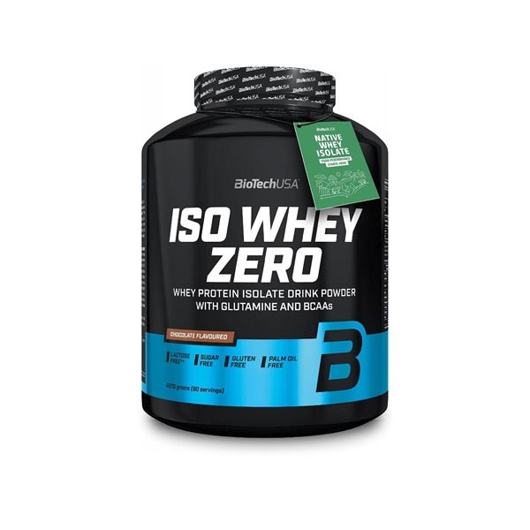

Problem
290grams of pastic in the jar that contains 90 scoops
180%co2

Slide 9



Point of view template
USERS
(be very specific)
NEEDS
(verb)
SURPRISING
(insights)
Needs to
because
Cafeterias which are located in Gyms that serve fitness supplements
To efficiently serve a high volume of customers in a way that minimizes service time and reduces product loss
These cafeterias often face challenges in quickly weighing supplement doses in grams
HOW MIGHT WE
POV STATEMENT
How might we achieve high accuracy in weighting supplement doses in a faster way than the traditinal way or how we can elimenate the weighting part?
Gym cafeteria managers need a more efficient method for weighing supplement doses to reduce wait times and product loss.

Slide 10
POV STATEMENT
Point of view template
End users need a method to affordably purchase supplements in small, varied quantities to experiment with different types without committing large volumes
USERS
(be very specific)
NEEDS
(verb)
SURPRISING
(insights)
Needs to
A simple and easy preparation method also needs a variety of supplements and
flavors at an affordable cost
because
End users prefer purchasing multiple supplements in small, affordable quantities with diverse flavors
End users who like to have their supplements in their homes
FINAL CHALLENGE STATEMENT
HOW MIGHT WE
Both, personas are looking for more affordable and flexible supplement product
HMW offer supplements in smaller amounts that allows the user customize their supplemnts types and flavers?

Slide 11

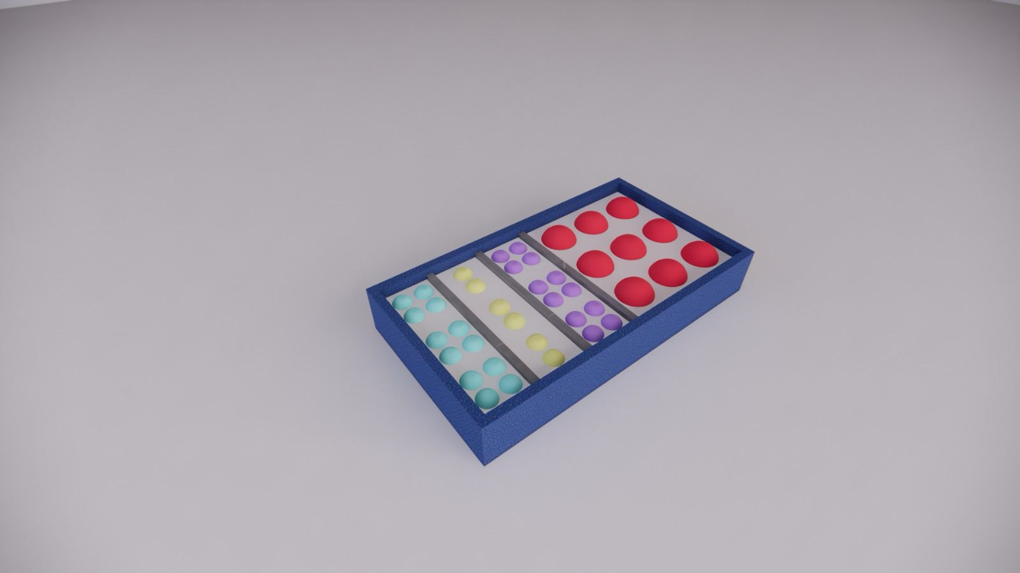

Business idea
Achieve our main goal
Achieve the customers needs
⁠Reduction of plastic waste
Simplicity of preparation
Eco-friendly packaging for the capsule and the package
Achieve the needs of multiple supplements and flavors
Decrease the loss

Slide 12

Tools
1- Emphasizing
2- Brainstorming
3- Mind Map
4- Inductive Reasoning
Divergent Thinking

Slide 13
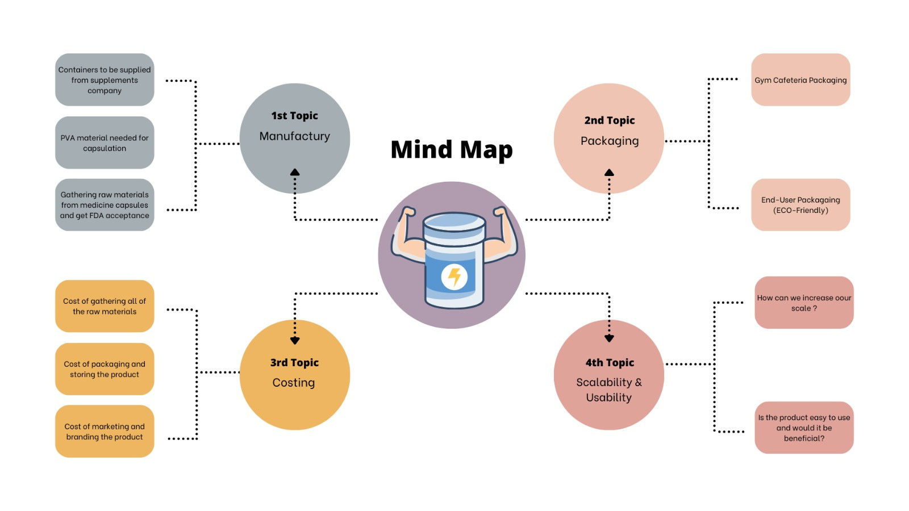

Slide 14
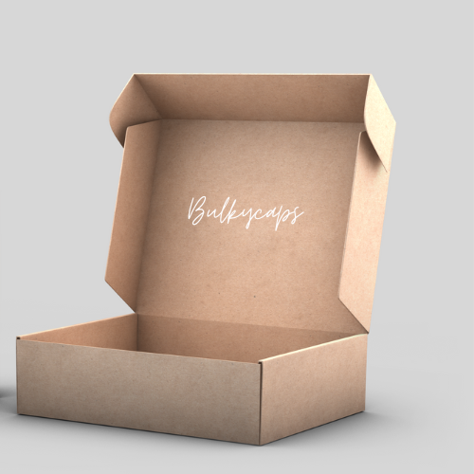
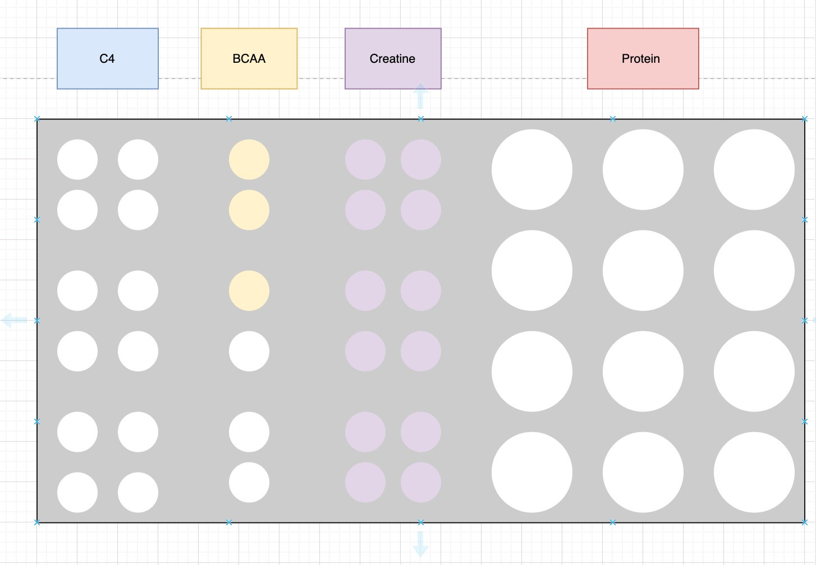
Prototype
⁠Iteration number one was done as a sketch by Draw.io
⁠Iteration number two

Slide 15
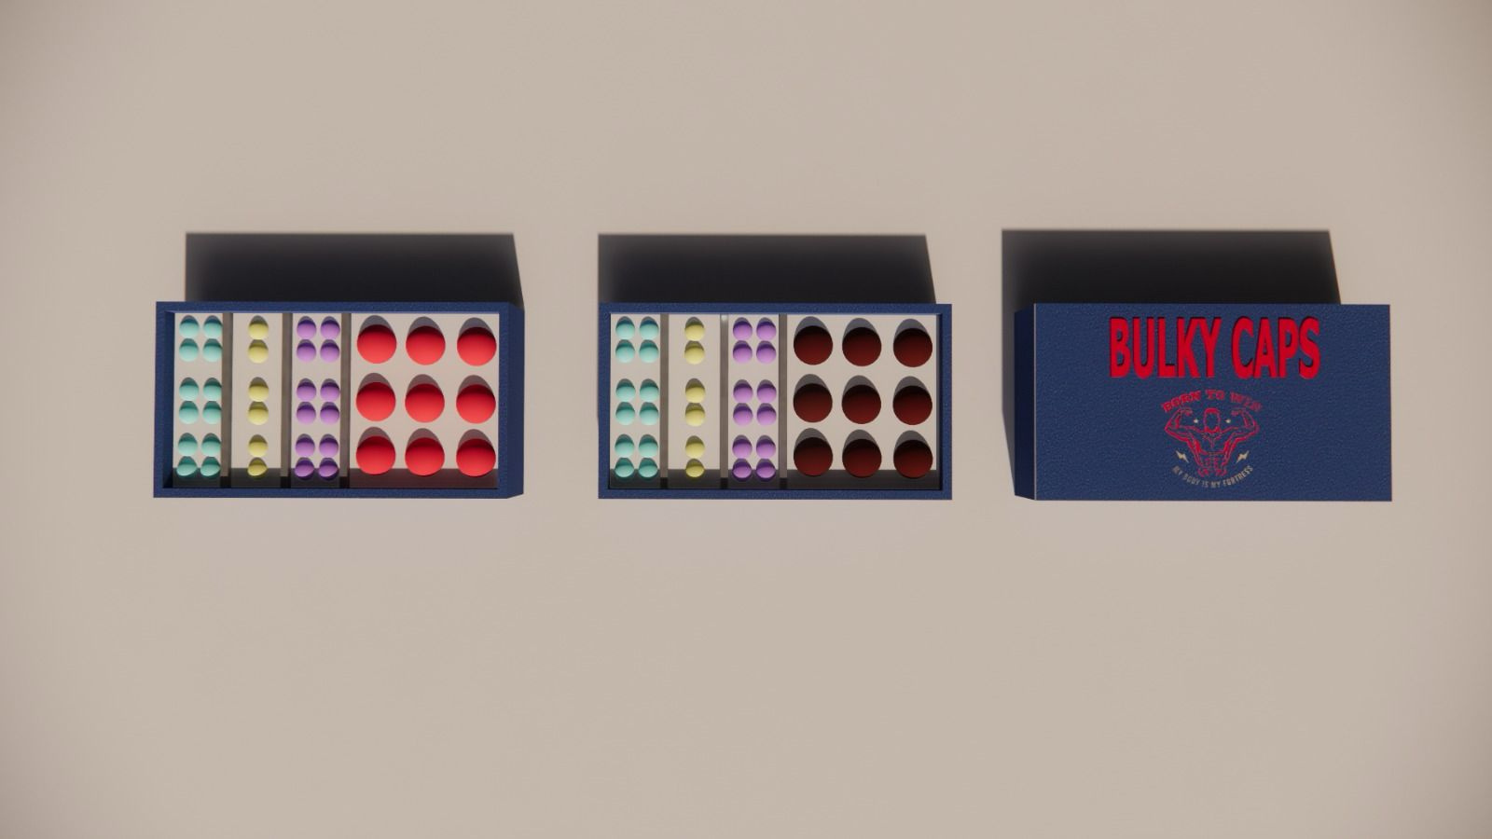

Prototype
⁠Iteration number three was a 3d model
⁠Iteration number three was a 3d model

Slide 16
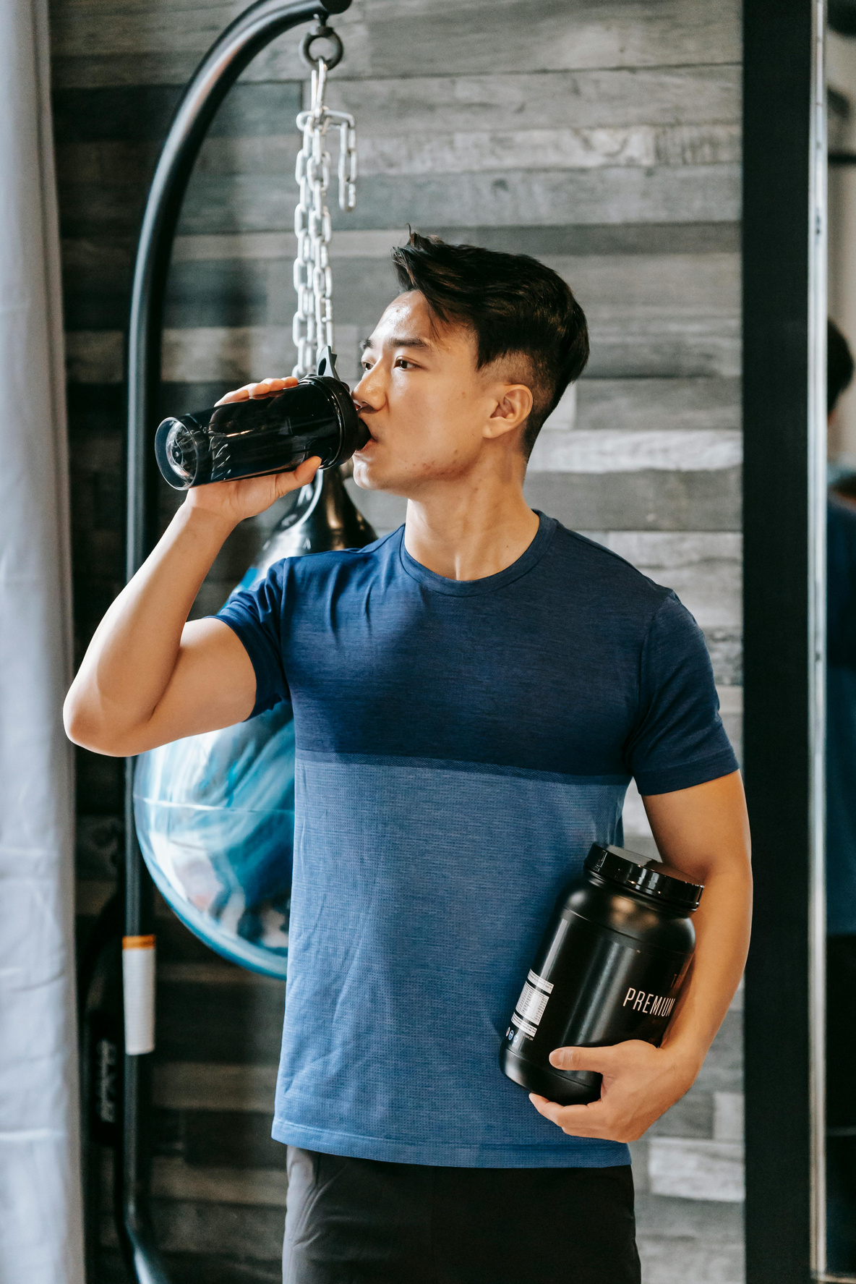
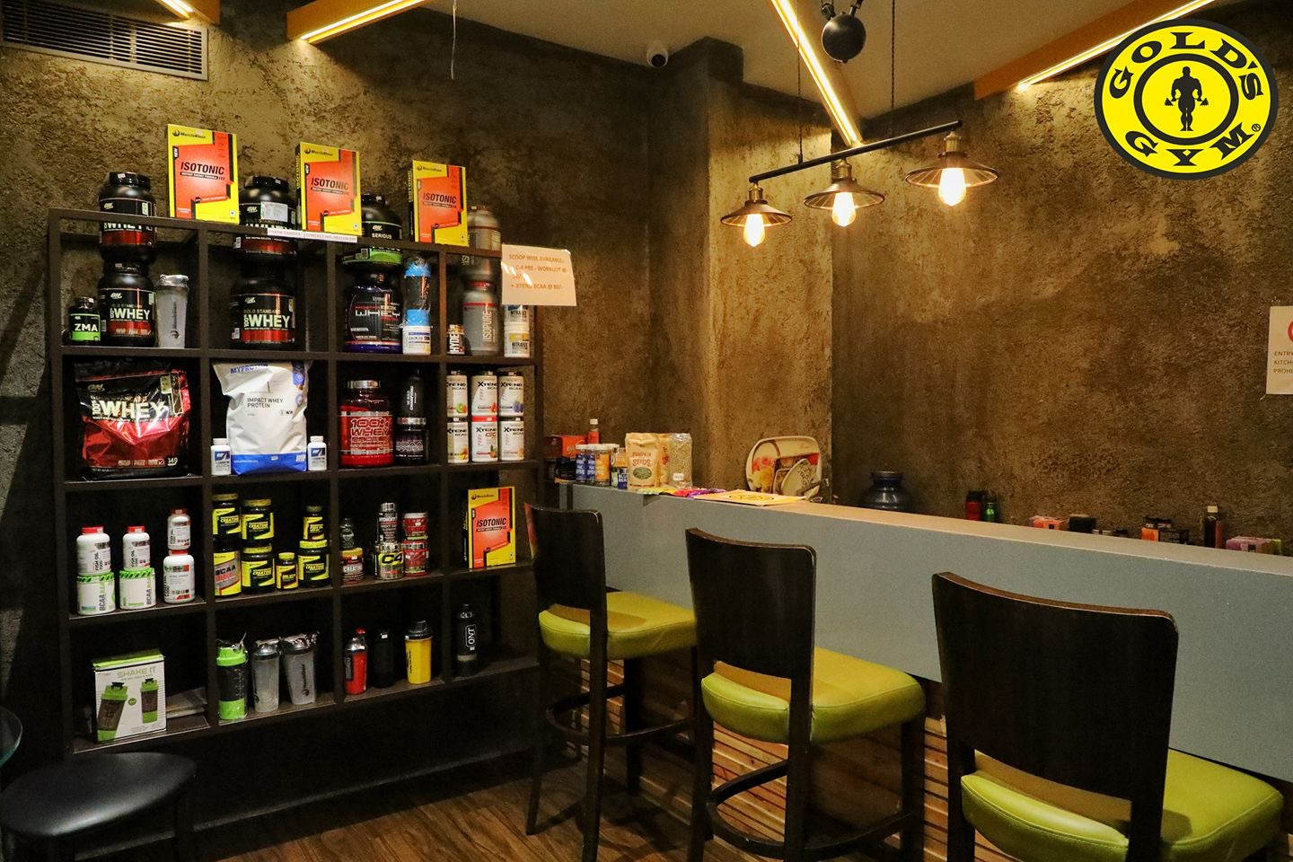
Feedback

Slide 17
Explaination for the prototype
Usabiliy
Scalability
possibility

Slide 18



THANK YOU
"Strength in Every capsule: Power Up with BulkyCaps!"
CREATIFORCE
Calle Cualquiera 123, Cualquier Lugar

